Slide 1

MCTS Guide to Configuring Microsoft Windows Server 2008 Active Directory
Chapter 1: Introducing Windows Server 2008

Slide 2
Objectives
Explain the function of a server in a network environment
Describe the editions of Windows Server 2008
Discuss core technologies
Explain the primary roles a Windows Server 2008 computer can fulfill
Describe the new and enhanced features of Windows Server 2008
MCTS Windows Server 2008 Active Directory

Slide 3
The Role of a Server Operating System
Hardware or Software? Server software is ambiguous; can run on multiple different platforms (i.e., laptop)
Windows Server 2008 roles short summary:
  File and Printer sharing
  Web server
  Routing and Remote Access Services (RRAS)
  Domain Name System (DNS)
  Dynamic Host Configuration Protocol (DHCP)
  File Transfer Protocol (FTP) Server
  Active Directory
  Distributed File System (DFS)
  Fax Server
MCTS Windows Server 2008 Active Directory

Slide 4
Windows Server 2008 Editions
Windows Server 2008 Standard Edition
  Smaller organizations consisting of a few hundred users or less
Windows Server 2008 Enterprise Edition
  Larger companies with more needs
Windows Server 2008 Datacenter Edition
  Companies that run high-powered servers with considerable resources
Windows Web Server 2008
  Similar to Standard; user base varies from small businesses to corporations with large departments
MCTS Windows Server 2008 Active Directory

Slide 5
Windows 2008 Standard Edition
Up to four physical processors allowed
Available in 32-bit or 64-bit versions
32-bit version supports up to 4 GB of RAM; 64-bit version up to 32 GB
Lacks more advanced features, such as clustering
64-bit version can install one virtual instance of Server 2008 Standard Edition with Hyper-V
MCTS Windows Server 2008 Active Directory

Slide 6
Windows Server 2008 Enterprise Edition
All the features of Standard Edition
Up to eight physical processors
32-bit version supports 64 GB RAM; 64-bit version supports 2 TB
Can be clustered; up to 16 cluster nodes permitted
Hot-add memory
Four virtual instances per license with Hyper-V
MCTS Windows Server 2008 Active Directory

Slide 7
Windows Server 2008 Datacenter Edition
All the features of Enterprise Edition
Up to 32 physical processors in 32-bit version; 64 processors in 64-bit
Extra fault tolerance features: hot-add and hot-replace memory or CPU
Can’t be purchased as individual license, only through volume license or through OEMs (preinstalled)
Unlimited number of virtual instances
MCTS Windows Server 2008 Active Directory

Slide 8
Windows Web Server 2008
Designed to run Internet Information Services (IIS) 7.0
Hardware support similar to Standard Edition
Lacks many of the features present in other editions
Typically used when roles such as Active Directory or Terminal Services are not required
MCTS Windows Server 2008 Active Directory

Slide 9
System Requirements (All Editions)
Component | Requirement
Processor | Minimum: 1 GHz for x86 CPU or 1.4 GHz for x64 cpu Recommended: 2 GHz or faster
Memory | Minimum 512 MB RAM Recommended: 2 GB RAM or more
Available disk space | Minimum: 10 GB Recommended: 40 GB or more
Additional drives | DVD-ROM
Display and peripherals | Super VGA or higher Keyboard and mouse
MCTS Windows Server 2008 Active Directory

Slide 10
Windows Server 2008 Core Technologies
New Technology File System
Active Directory
Microsoft Management Console
Disk Management
File and printer sharing
Windows networking
Internet Information Services
MCTS Windows Server 2008 Active Directory

Slide 11
NTFS
New Technology File System
Successor to FAT/FAT32
Native support for long filenames, file and folder permissions, support for large files and volumes, reliability, compression, and encryption
Most significant is the added ability for more granular file access control
MCTS Windows Server 2008 Active Directory

Slide 12
Active Directory
Provides a single point of administration of resources (users, groups, shared printers, etc.)
Provides centralized authentication and authorization of users to network resources
Along with DNS, provides domain-naming services and management for a Windows domain
Enables administrators to assign system policies, deploy software to client computers, and assign permissions and rights to users of network resources
MCTS Windows Server 2008 Active Directory

Slide 13
Microsoft Management Console (MMC)
Creates a centralized management interface for administrators
Uses snap-ins, which are designed to perform specific administrative tasks (such as disk management or active directory configuration)
Multiple snap-ins can be combined into a single MMC, providing quicker access to commonly used tools
MCTS Windows Server 2008 Active Directory

Slide 14
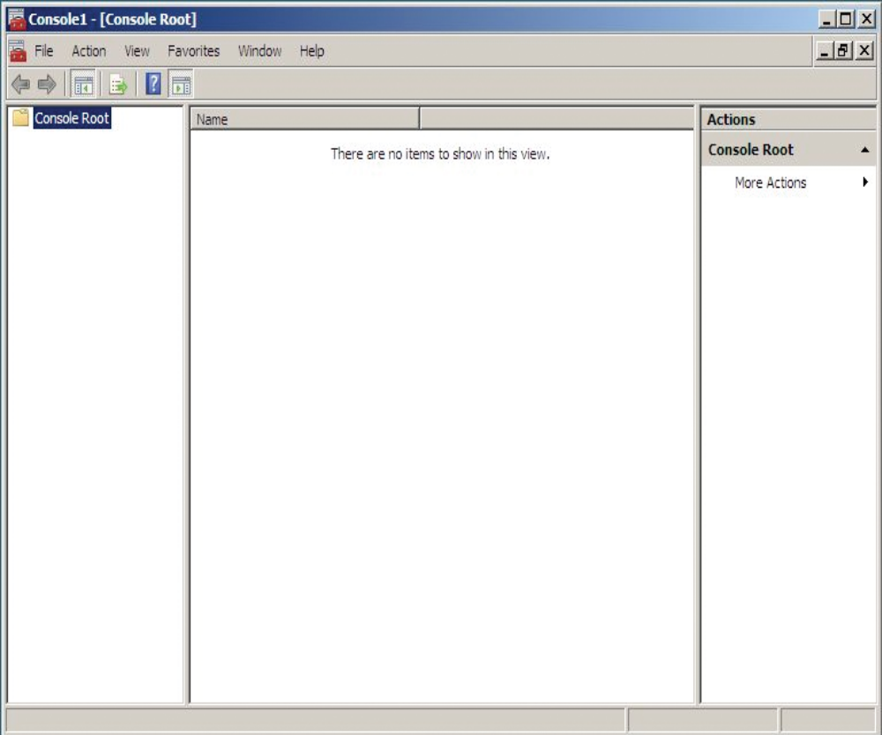
Microsoft Management Console (MMC) (cont.)

Slide 15
Disk Management
Monitors disk and volume status
Initializes new disks
Creates and formats new volumes
Troubleshoots disk problems
Configures redundant disk configurations (RAID)
MCTS Windows Server 2008 Active Directory

Slide 16
File and Printer Sharing
Shadow copies
Disk quotas
Distributed File System (DFS)
Also possible to configure options that allow redundancy, version control, and user storage restrictions
MCTS Windows Server 2008 Active Directory

Slide 17
Windows Networking Concepts
The Workgroup Model
  A small group of computers that share common roles, such as sharing files or printers
  Also called a peer-to-peer network
  Decentralized logons, security, and resource sharing
  Easy to configure and works well for small groups of users (fewer than 10)
  A Windows Server 2008 server that participates in a workgroup is referred to as a stand-alone server
MCTS Windows Server 2008 Active Directory

Slide 18
Windows Networking Concepts (cont.)
The Domain Model
  Preferred for a network of more than 10 computers or a network that requires centralized security and resource management
  Requires at least one computer to be a domain controller
  A domain controller is a Windows server that has Active Directory installed and is responsible for allowing client computers access to domain resources
  A member server is a Windows Server that’s in the management scope of a domain but doesn’t have Active Directory installed
MCTS Windows Server 2008 Active Directory

Slide 19
Windows Networking Components
Network Interface
  Composed of two parts: the network interface card (NIC) and the device driver software
Network Protocol
  Specifies the rules and format of communication between network devices
Network Client and Server Software
  Network client sends requests to a server to access network resources
  Network server software receives requests for shared network resources and makes those resources available to a network client
MCTS Windows Server 2008 Active Directory

Slide 20
Internet Information Services
Windows Server 2008 provides IIS 7.0
Modular design
  Unused features aren’t available for attackers to exploit
Extensibility
  Functionality is easily added via modular design
Manageability
  Delegated administration; can assign control over some aspects of the Web site to developers and content owners
  Appcmd.exe provides the ability to manage IIS via scripts and batch files
MCTS Windows Server 2008 Active Directory

Slide 21
Windows Server 2008 Roles
Server role is a major function or service that a server performs
Role services add functions to main roles
Server features provide functions that enhance or support an installed role or add a stand-alone function
A server can be configured for a single role or multiple roles
MCTS Windows Server 2008 Active Directory

Slide 22
Active Directory Certificate Services
A digital certificate is an electronic document containing information about the certificate holder and the entity that issued the certificate
The Active Directory Certificate Services role provides services for creating, issuing, and managing digital certificates
AD CS can include other server roles for managing certificates
MCTS Windows Server 2008 Active Directory

Slide 23
Active Directory Domain Services
Active Directory Domain Services (AD DS) installs Active Directory and turns Windows Server 2008 into a domain controller
Read Only Domain Controller (RODC)
  Provides the same authentication and authorization services as a standard domain controller
  Changes cannot be made on an RODC directly
  Updated periodically by replication from standard domain controllers
MCTS Windows Server 2008 Active Directory

Slide 24
Other Active Directory Related Roles
Active Directory Federation Services (AD FS)
Active Directory Lightweight Directory Services (AD LDS)
Active Directory Rights Management Services (AD RMS)
MCTS Windows Server 2008 Active Directory

Slide 25
Application Server
Provides high-performance integrated environment for managing, deploying, and running client/server business applications
Applications for this role usually built with one or more of the following technologies: IIS, ASP.NET, Microsoft .NET Framework, COM+, and Message Queuing
MCTS Windows Server 2008 Active Directory

Slide 26
DHCP Server
Dynamic Host Configuration Protocol Server role provides automatic IP address assignment and configuration for client computers
Can provide default gateway address, DNS server addresses, WINS server addresses, and other options
Windows Server 2008’s DHCP server role provides support for IPv6
MCTS Windows Server 2008 Active Directory

Slide 27
DNS Server
DNS Server resolves the names of Internet computers and computers that are members of a Windows Domain to their assigned IP addresses
When installing Active Directory, you can specify an existing DNS server or install DNS on the same server as Active Directory
MCTS Windows Server 2008 Active Directory

Slide 28
Fax Server
Provides tools to manage shared fax resources and allow users to send and receive faxes
After the role is installed, you can:
  Manage users who have access to fax resources
  Configure fax devices
  Create rules for routing incoming and outgoing faxes
  Monitor and log use of fax resources
MCTS Windows Server 2008 Active Directory

Slide 29
File Services
Provide high-availability, reliable, shared storage to Windows and other client OSs
Installing File Services role installs the File Server service automatically
MCTS Windows Server 2008 Active Directory

Slide 30
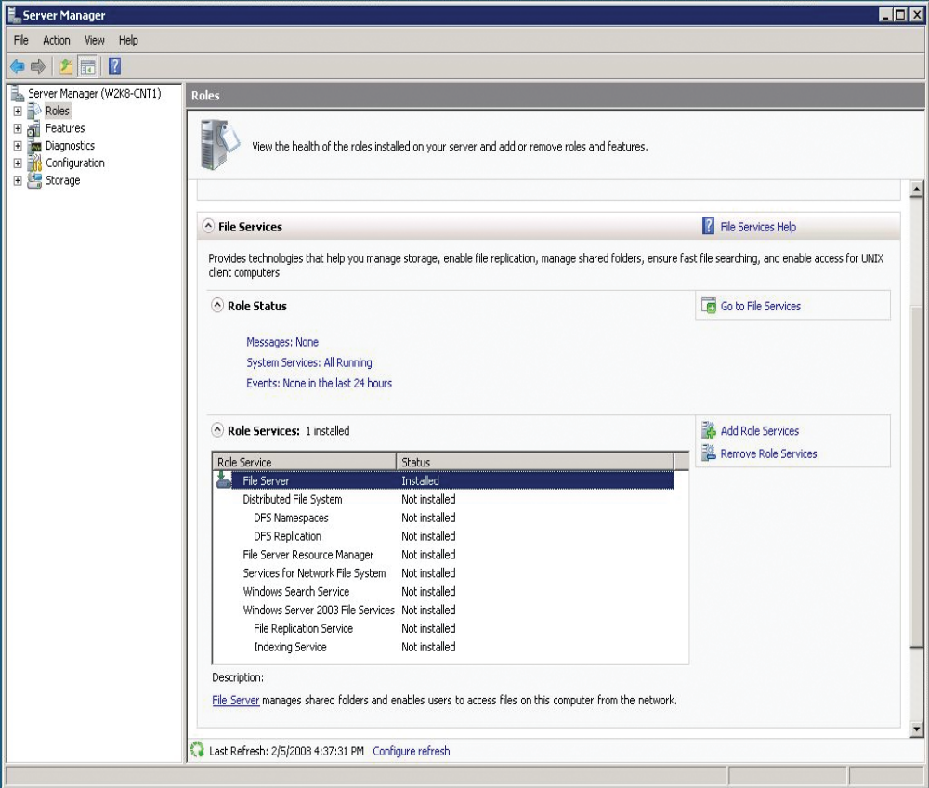
File Services (cont.)

Slide 31
Hyper-V
Provides services to create and manage virtual machines on a Windows Server 2008 computer
A virtual machine is a software environment that simulates the computer hardware an OS requires for installation
Installing an OS on a virtual machine is done using the same methods used on a physical machine
MCTS Windows Server 2008 Active Directory

Slide 32
Network Policy and Access Services
Provides Routing and Remote Access Services (RRAS)
Other services that can be installed
  Network Policy Server (NPS)
  Health Registration Authority (HRA)
  Host Credential Authorization Protocol (HCAP)
MCTS Windows Server 2008 Active Directory

Slide 33
Print Services
Enables administrators to manage access to network printers
Installs Print Server by default
Internet Printing role service enables Web-based management of network printers
Line Printer Daemon (LPD) role service provides compatibility with Linux/UNIX clients
MCTS Windows Server 2008 Active Directory

Slide 34
Terminal Services
Enables users and administrators to control a Windows desktop remotely / run applications hosted on a server remotely
Terminal server role permits up to two simultaneous remote desktop sessions
Additional sessions require TS Licensing role service and license purchases
Other roles
  TS Sessions Broker
  TS Gateway
  TS Web Access
MCTS Windows Server 2008 Active Directory

Slide 35
UDDI Services
Universal Description, Discovery, and Integration (UDDI) Services enables administrators to manage, catalog, and share Web services
Allows users to search for Web services available to them
Gives developers a catalog of existing applications and development work
MCTS Windows Server 2008 Active Directory

Slide 36
Web Server (IIS)
Consists of role services Web Server, management tools, and FTP publishing
Secondary role services can be installed for additional features
MCTS Windows Server 2008 Active Directory

Slide 37
Windows Deployment Services
Simplifies the installation of Windows over a network
Can install and remotely configure Windows Vista and Server 2008 systems
WDS is an improved version of Remote Installation Services (RIS) found in Windows Server 2000 and 2003
MCTS Windows Server 2008 Active Directory

Slide 38
New Features in Windows Server 2008
Server Manager
Server Core
Hyper-V virtualization
Storage management enhancements
Networking enhancements
Network Access Protection
Windows Deployment Services
New Active Directory roles
Terminal Services enhancements
MCTS Windows Server 2008 Active Directory

Slide 39
Server Manager
Provides a single interface for installing, configuring, and removing a variety of server roles and features on a server
Summarizes server status and configuration
Includes tools to diagnose problems, manage storage, and perform general configuration tasks
Consolidates tools from Windows Server 2003
MCTS Windows Server 2008 Active Directory

Slide 40
Server Core
Has a minimum environment and lacks a full GUI
Can install the following server roles:
  Active Directory Domain Services (AD DS)
  Active Directory Lightweight Directory Services (AD LDS)
  Dynamic Host Configuration Protocol (DHCP) Server
  DNS Server
  File Services
  Print Server
  Streaming Media Services
  Web Server
  Hyper-V
MCTS Windows Server 2008 Active Directory

Slide 41
Server Core (cont.)
Core supports additional features to enhance server roles
  Microsoft Failover Clustering
  Network Load Balancing
  Subsystem for UNIX-based Applications
  Windows Backup
  Multipath I/O
  Removable Storage Management
  Windows Bitlocker Drive Encryption
  Simple Network Management Protocol (SNMP)
  Windows Internet Naming Service (WINS)
  Telnet client
  Quality of Service (QOS)
MCTS Windows Server 2008 Active Directory

Slide 42
Server Core (cont.)
Server Core lacks the ability to install the following server roles (and their optional features):
  Application Server
  Active Directory Rights Management Services
  Fax Server
  UDDI Services
  Windows Deployment Services
  Active Directory Certificate Services
  Network Policy and Access Services
  Terminal Services
  Active Directory Federation Services
MCTS Windows Server 2008 Active Directory

Slide 43
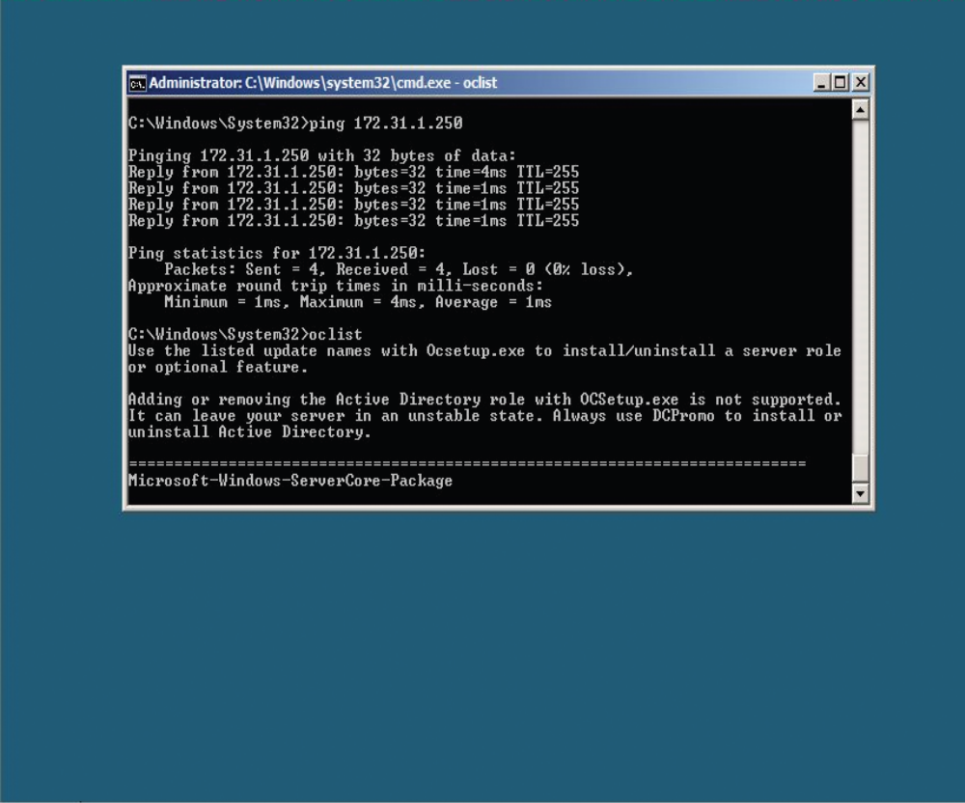
Server Core (cont.)

Slide 44
Hyper-V
Virtualization isolates critical applications
Virtualization helps to consolidate multiple physical servers into a singular server
Using a virtual machine increases the ease of backing up essential servers
Updates or changes to an OS can be made on a virtual machine to test stability before being applied to a production machine
Reduces the need for physical devices in educational environments
MCTS Windows Server 2008 Active Directory

Slide 45
Hyper-V (cont.)
Hyper-V Requirements
  64-bit version of Windows Server 2008 Standard, Enterprise, or Datacenter Edition
  A server running a 64-bit processor with virtualization support and hardware data execution protection
  Enough free memory and disk space to run virtual machines and store virtual hard drives; virtual machines use the same amount of memory and disk space resources as physical machines
MCTS Windows Server 2008 Active Directory

Slide 46
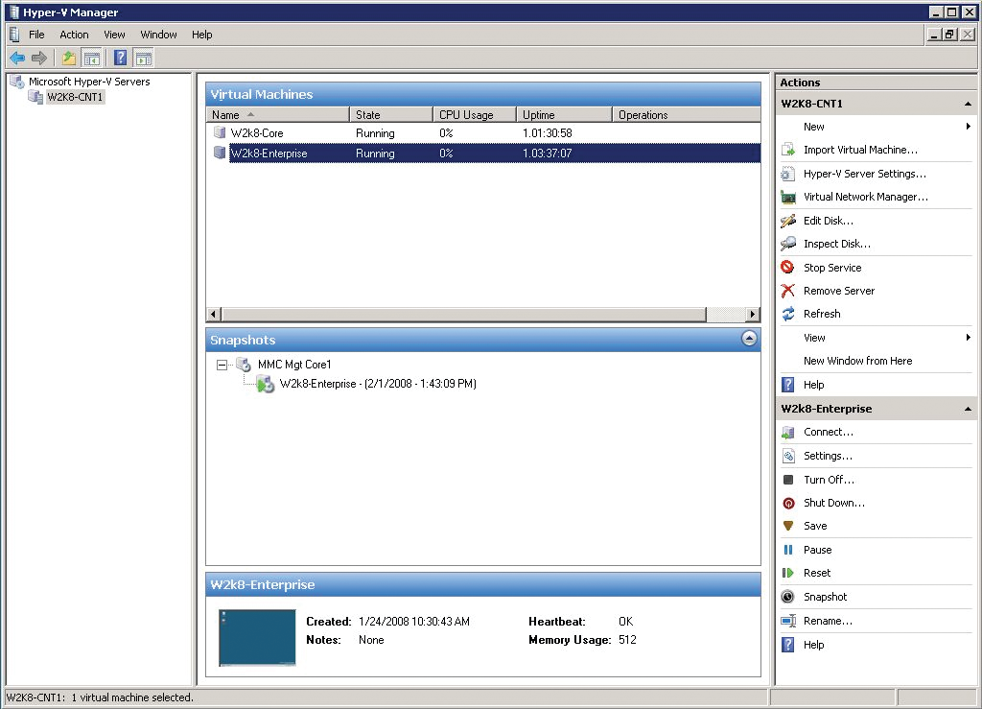
Hyper-V (cont.)

Slide 47
Storage Management Enhancements
Share and Storage Management MMC Snap-in
File Server Resource Manager
Windows Server Backup
Other improvements include:
  Storage Explorer
  SMB 2.0
  Remote boot support
MCTS Windows Server 2008 Active Directory

Slide 48
Networking Enhancements
Improved support for IPv6
  DHCPv6
  Load balancing
Redesigned TCP/IP stack
  Improved performance, error detection, and recovery
Virtual Private Networking
  Secure Socket Tunneling Protocol (SSTP)
MCTS Windows Server 2008 Active Directory

Slide 49
Network Access Protection
Ensures computers are equipped with required security features
Enables monitoring of antivirus software and firewall settings
If a computer does not meet all requirements defined by an administrator, it can be restricted automatically from accessing certain network resources
Can force computers to update themselves
MCTS Windows Server 2008 Active Directory

Slide 50
Windows Deployment Services
Updates Remote Installation Services
Allows unattended installation of Windows OSs
WDS can multicast deployment of disk images, reducing network bandwidth required
Includes tools to customize the Windows OS for deployment
MCTS Windows Server 2008 Active Directory

Slide 51
New Active Directory Roles
Active Directory Lightweight Directory Services (AD LDS)
  Provides tighter integration for applications that require large amounts of data retrieval; does not require a domain controller or domain
Active Directory Federation Services (AD FS)
  Provides single sign-on for users of an organization to access internal resources as well as external resources inside of a partner organization
Active Directory Rights Management Services (AD RMS)
  Helps the author of a document decide how a document can be used or modified, and deny unauthorized users access
MCTS Windows Server 2008 Active Directory

Slide 52
Terminal Services Enhancements
RemoteApp
  Rather than accessing a program on a server through remote desktop, the application appears as if it is actually running locally
Terminal Services Web Access (TS Web Access)
  Allows users to access applications through a Web browser, requiring no additional software for the client if running Vista
  Can list available RemoteApp programs
  Allows secure, encrypted connections using Secure HTTP (HTTPS) without the need for a VPN
MCTS Windows Server 2008 Active Directory

Slide 53
Chapter Summary
A server is defined more by the software installed on hardware as opposed to the hardware in use; in many cases, a client OS can behave as a server
Windows Server 2008 is available in four editions: Standard, Enterprise, Datacenter, and Windows Web Server 2008
Core technologies in Windows Server 2008 include NTFS, Active Directory, MMC, disk management, file and printer sharing, networking components, and IIS
Windows Server 2008 updates previously available services with additional functionality, while adding several new services
MCTS Windows Server 2008 Active Directory

